Slide 1
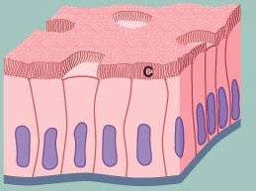
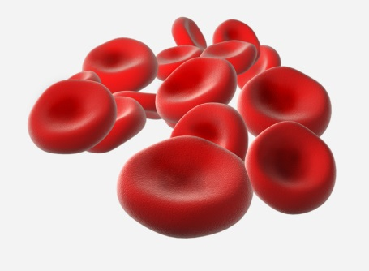
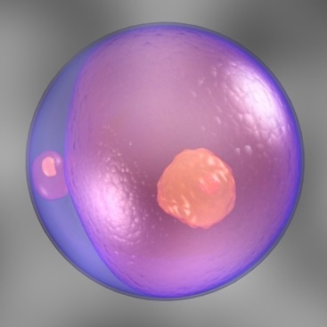
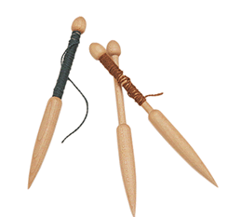
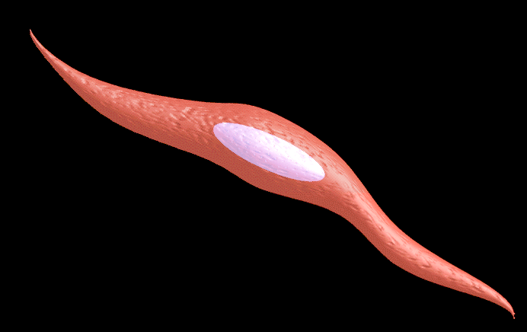
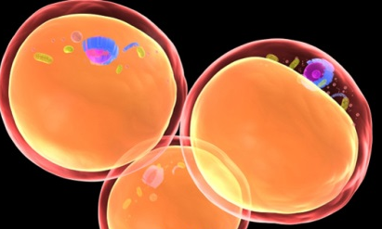
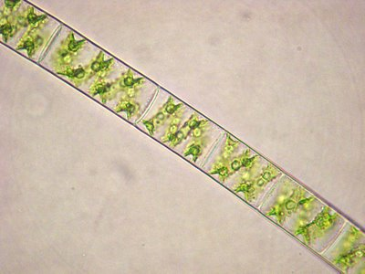
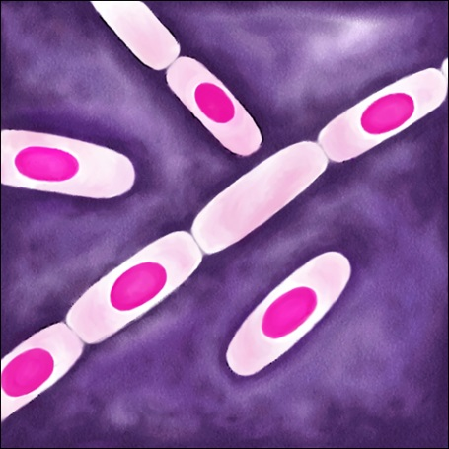
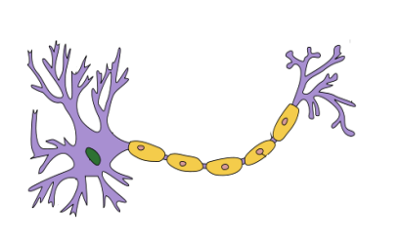
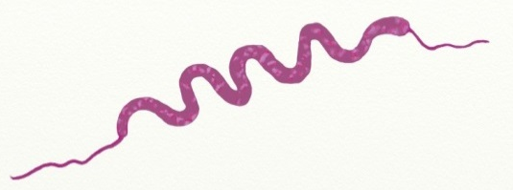

Shapes of Cells
Eg. Epithelial cells
Columnar
The shape and size of the cells are related to the specific function they perform.
Different cells have different shapes depending on their functions.
Like
Eg. RBCs
Circular biconcave
Shaped like columns
Spindle shaped
Eg. Smooth muscle cells
Oval
Eg. Ovum or egg cell
Shaped like a spindle. Spindle is a device to spin fibers into threads.
Irregular
Eg. Amoeba
Eg. Fat cells
Circular
Branched
Eg. Nerve cell
Spiral
Eg. Spirillum bacteria
Spring shaped
Rectangular
Eg. Cells of Spirogyra
Rod shaped
Eg. Bacillus bacteria

Slide 2
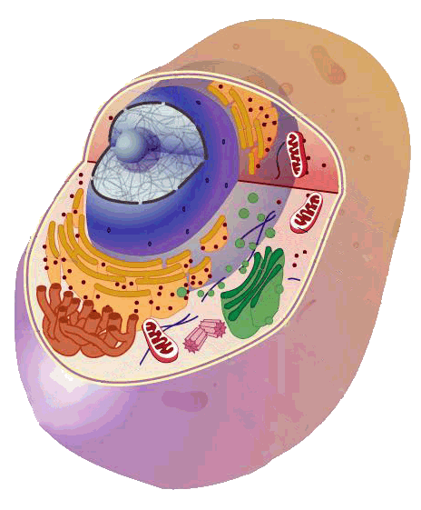
Cell structure
A cell is made up of different components like
Cell wall (Found only in plants)
Plasma membrane
Cytoplasm
Cell organelles
Let us see them one by one

Slide 3
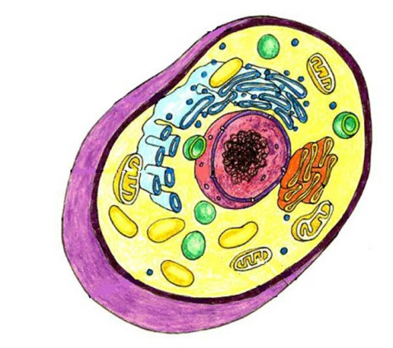
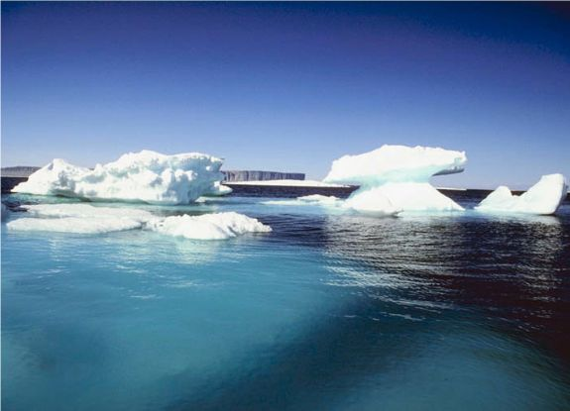
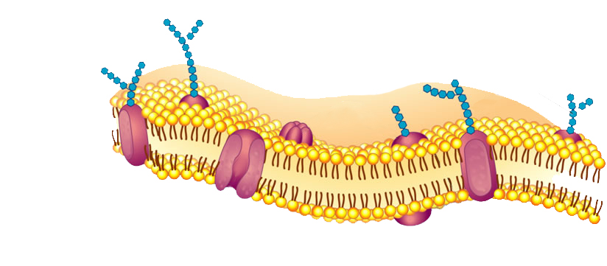
Plasma membrane
It is also called as cell membrane
It is the thin outer covering of a cell.
Cell Membrane
It separates the contents of the cell from external environment.
The plasma membrane is flexible and is made up of organic molecules called lipids and proteins.
Proteins
Lipids

Slide 4
Plasma membrane
The plasma membrane allows or permits the entry and exit of some materials in and out of the cell.
It also prevents the movement of some other materials.
Therefore, the plasma membrane is called as a selectively permeable membrane.

Slide 5

How does the movement of substances take place inside and outside the cell?

Slide 6
For e.g. when the concentration of CO₂ inside the cell increases, the CO₂ moves out of the cell by diffusion.
From high concentration to low concentration
Similarly when the concentration of O₂ inside the cell decreases, the O₂ moves from outside to inside of the cell.
O₂
O₂
CO₂
CO₂
O₂
O₂
CO₂
CO₂
CO₂
O₂
CO₂
O₂
CO₂
O₂

